Slide 1
Algorithmic Analysis
Unit 4

Slide 2
Choosing the Best Algorithm
Suppose you are running experiments on people riding roller coasters in terms of gender, age, time of day, and weather
It depends!
You want to be able to sort the data by any of the factors
What is the best sort algorithm to use?

Slide 3
Algorithmic Analysis
Determining effect of increasing the size of the data set on an algorithm
Independent of computer platforms & execution speed of computer platforms
Can analyze time or space effect
a.k.a. Complexity Analysis or Asymptotic Analysis

Slide 4
Big-Oh Notation
Represents the efficiency or complexity of an algorithm with regard to time or space (memory)
Characterizes an algorithm’s behavior for very large tasks (data set size)
Big-Oh is the upper bound – a simplification

Slide 5
Open TimingTester.java
In Google Classroom, open the “Timer Tester” assignment
With your neighbors (groups of 2 or 3), run each option in the program with the requested array sizes
Enter the reported times in the chart
As a group, decide which phrase best represents the growth in time
Share doc with group members & submit

Slide 6
Big-Oh Notation
Big-Oh | Description | Example
O(1) | Constant As n increases, task stays the same | Random access of array
O(log n) | Logarithmic As n doubles, task increases by small amount | Binary Search
O(n) | Linear As n increases, task increases at same rate | Traversing 1-D array, List

Slide 7
Big-Oh Notation
Big-Oh | Description | Example
O(n log n) | Linearithmic As n increases, task increases faster than n, but slower than n² | Merge Sort
O(n²) | Quadratic As n increases, task increases at n² rate | Selection Sort
O(2^{n}) | Exponential Each time n increases by 1, task doubles | Recursive Fibonacci

Slide 8
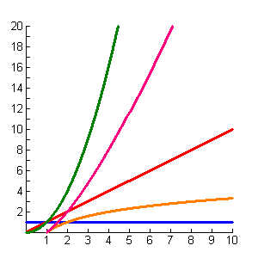
Comparing Complexity
O(n²)
O(n log n)
O(n)
O(log n)
O(1)

Slide 9
Formal Definition of Big-Oh
T(N) is O( f(n) ) if there are positive constants c and N₀ such that
T(N) ≤ cF(N) when N ≥ N₀

Slide 10


Slide 11
Formal Definition of Big-Oh
N = size of data set
T(N) is O( f(n) ) if there are positive constants c and N₀ such that
T(N) ≤ cF(N) when N ≥ N₀
T(N) is the algorithm’s actual growth rate
F(N) is the function that bounds the growth rate
T(N) characterizes the algorithm’s actual running time
F(N) characterizes an upper bounds on T(N)

Slide 12
Consider the Following
N + 1 times
1 time
1 time
N times
public int calcSum(int[] arr)
{
int sum = 0;
for (int k = 0; k < arr.length; k++)
sum += arr[k];
return sum;
}
T(N) = 3N + 4
N times
1 time

Slide 13
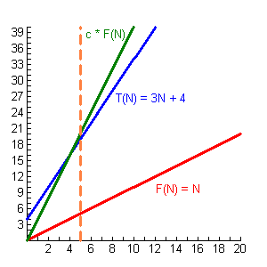
c = 4, c * F(N) = 4N
O(N)
F(N) = N
Because if c=4, then
4N >= T(N) when N >= 5
N₀ = 5

Slide 14
Another Example
N + 1 times
1 time
N times
public void stuff(ArrayList<Integer> nums, int n)
{
for (int k = 1; k <= n; k++)
{
int rand = (int) (Math.random() * 6) + 1;
nums.add(0, rand);
}
}
N times
T(N) = N² + 3N + 2
F(N) = N²
Inserting at front is O(N) and is called N times
– N * N total

Slide 15
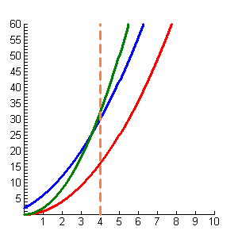
O(N²)
c * F(N)
F(N) = N²
T(N) = N² + 3N + 2
F(N) = N²
Because if c=2, then
2N² >= T(N) when N >= 4
N₀ = 4

Slide 16
Another Example
How many iterations when N = 100?
O(log N)
N = 200?
N = 400?
public void stuff(int[] arr)
{
for (int k = 1; k < arr.length; k *= 2)
{
arr[k] = k * k;
}
}
If doubling the data set causes the statements to increase by a constant amount, it’s logarithmic efficiency
Doubling (or tripling or halving) each time through loop causes logarithmic effect

Slide 17
What About Nested Loops?
O(N²)
public int calcSum(int num)
{
int sum = 0;
for (int x = 0; x < num; x++)
for (int y = 0; y < num; y++)
{
sum += (x * y);
}
return sum;
}
Nested loops typically quadratic efficiency

Slide 18
More Nested Loops…
O(1)
public int calcSum(int[][] matrix, int row, int col)
{
int sum = 0;
for (int r = row - 1; r <= row + 1; r++)
for (int c = col - 1; c <= col + 1; c++)
if (r >= 0 && r < matrix.length &&
c >= 0 && c < matrix[0].length)
sum += matrix[r][c];
return sum;
}
Always makes at most 9 addition statements!

Slide 19
Function T(N) to Big-Oh O(n)
Identify which part of the function has the biggest impact.
Not sure? Let n = 1,000,000 and see which part has the biggest value
Eliminate any constant: 4N² becomes N²
25n² + 87n + 17 → 25n² → O(n²)
10n + 3n⁵ + 2n² + 95 → 3n⁵ → O(n⁵)

Slide 20
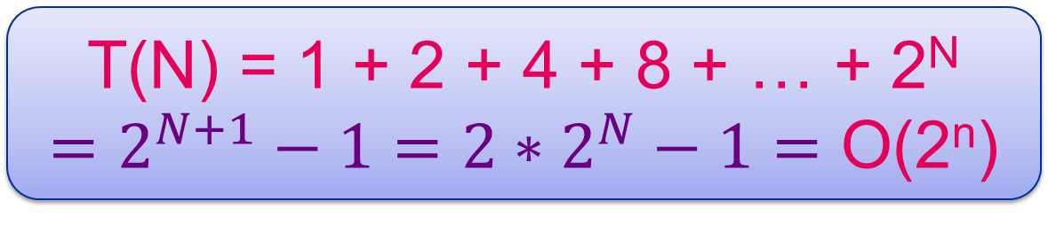
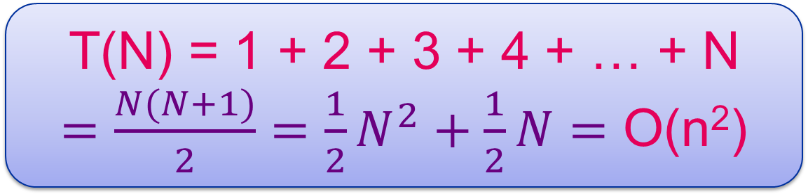
Common Summations
T(N) = 1 + 2 + 3 + 4 + … + N
$=\frac{N(N+1)}{2}=\frac{1}{2}N^{2}+\frac{1}{2}N=$ O(n²)
T(N) = 1 + 2 + 4 + 8 + … + 2^{N}
$=2^{N+1}−1=2∗2^{N}−1=$ O(2^{n})

Slide 21
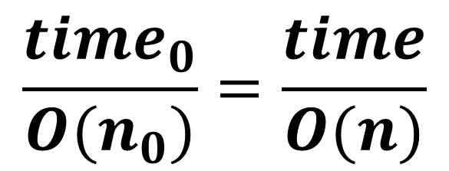
The oops algorithm takes 50 milliseconds to process a data set with 5,000 elements.
How long will oops take to process a data set with 7,500 elements, if the Big-Oh is…
How do we set this up?
Given time
$$\frac{{time}_{0}}{O(n_{0})}=\frac{time}{O(n)}$$
Target time
O( Given Size )
O( Target Size )

Slide 22
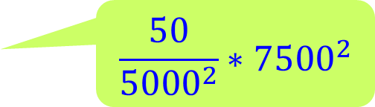
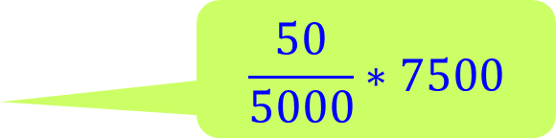

The oops algorithm takes 50 milliseconds to process a data set with 5,000 elements.
How long will oops take to process a data set with 7,500 elements, if the Big-Oh is…
$$\frac{50}{5000}∗7500$$
O(n)
75 ms
O(n²)
112.5 ms
$$\frac{50}{{5000}^{2}}∗{7500}^{2}$$
O(log n)
52.38 ms
$$\frac{50}{\log{5000}}∗\log{7500}$$

Slide 23
Quantifiers
Best Case – properties of the data set that causes the fewest steps in the algorithm
Worst Case – properties of the data set that causes the most steps in the algorithm
Average Case – typically means the data in the data set is randomly distributed

Slide 24
Inserting in a Sorted Array
Insert 40 into the following array:
20
35
50
40
65
50
80
65
80
40 < 80 slide 80 over
Insert 40 & increment the counter
40 < 50 slide 50 over
40 < 65 slide 65 over

Slide 25
Inserting Into Sorted Array
Complexity:
O(n)
Working backwards from next available index until insertion point found
If item to insert is less than next element to left, shift element to current location
Otherwise, insertion point found
Store insertion item at insertion point
Increase number of elements counter

Slide 26
Deleting From Array
Delete 40 from the following array:
20
35
40
50
50
65
65
80
80
Slide over the 80
Find the 40
Slide over the 50
Slide over the 65
Reduce the number of elements by 1

Slide 27
Deleting From Array
Complexity:
O(n)
Search for item to delete
If found
Traverse array from match location to end
Shift each element to previous location
Reduce number of elements count

Slide 28
Linear Search
Complexity:
O(n)
Also known as sequential search
Search sequentially through a list starting at the beginning until the target value is found or the end is reached
No specific order of values is required
Max comparisons: n (n is size of list)

Slide 29
Binary Search
While the target value is not found and the list has not been exhausted
Find the middle value of the list portion being searched
If it matches the target value, search is done
Otherwise, if target value is less than middle value, continue searching to left of middle value
Otherwise, continue searching to right of middle value

Slide 30
Binary Search
Complexity:
O(log n)
Requires that the list be IN ORDER
Max comparisons for list of size n:
Find lowest power of 2 that n is less than
That power is the maximum number of comparisons
Examples:
n =55 Max: 6 32 (2⁵) <= 55 < 64 (2⁶)
n =512 Max: 10 512 (2⁹) <= 512 < 1024 (2¹⁰)

Slide 31
Selection Sort
58
14
79
14
58
23
94
90
66
75
min
i
min
i
i
i
i
i
i
14
79
23
58
23
79
94
90
66
75
min
min
i
i
i
i
i
i
min
14
23
58
58
79
94
90
66
75
min
i
i
i
i
i

Slide 32
Selection Sort
14
23
58
79
66
94
90
66
79
75
14
23
58
66
94
75
90
79
75
94
14
23
58
66
75
90
79
79
90
94
14
23
58
66
75
79
90
90
94

Slide 33
Selection Sort
Complexity:
O(n²)
all cases
For each location
Search list from this location to the end for smallest (or largest if descending) value
Swap into this location
Makes N-1 passes (N is size of list)
Makes same number of comparisons even if list is already in order or in reverse order!

Slide 34
Insertion Sort
79
58
79
14
23
94
90
66
75
Key
pos - 1
58
14
79
58
14
14
79
23
94
90
66
75
Key
pos - 1
pos - 1
14
58
23
79
58
23
23
79
94
90
66
75
Key
pos - 1
pos - 1
pos - 1

Slide 35
Insertion Sort
94
14
23
58
79
94
90
66
75
Key
90
14
23
58
79
94
94
90
90
66
75
Key
66
14
23
58
79
66
90
79
94
90
66
94
75
Key
75
14
23
58
66
79
94
75
90
79
94
90
75
Key

Slide 36
Insertion Sort
For each element starting at 2nd element
Keep searching for insertion point as long as element is smaller than element in front of it
Insert element at insertion point
Makes N-1 passes (N is size of list)
Makes only N-1 comparisons if list is already in order
Max work load if reverse order
Complexity: O(n²)
When in order: O(n)

Slide 37
Merge Sort

Slide 38
Divide Array in Half Until Each “Half” is 1 Element
23
17
5
90
12
44
Base Case:
array with only 1 item
23
17
5
90
12
44
23
17
5
90
12
44
23
17
5
90
12
44

Slide 39
Merge Sorted Halves Together
23
17
5
90
12
44
17
23
5
12
90
44
5
17
23
12
44
90
5
12
17
23
44
90

Slide 40
Merge Sort
Divide-and-Conquer Algorithm
Divide the array in half
Recursively sort each half
Merge the sorted halves together
Significantly faster than quadratic sorts
Variation used by Collections.sort and for arrays of objects by Arrays.sort
Complexity: O(n log n)
all cases

Slide 41
Quick Sort

Slide 42
Make 1st Partition
58
79
14
23
94
90
66
75
23
79
14
14
58
58
23
23
79
14
23
94
90
66
75
Pivot
left
left
right
left
right
right
right
right
right
right

Slide 43
QuickSort Left Partition
14
23
79
58
94
90
66
75
14
14
Pivot
right
left

Slide 44
QuickSort Right Partition
14
23
79
58
94
90
66
75
75
79
94
79
58
94
90
66
75
94
94
Pivot
left
left
left
left
left
left
right

Slide 45
QuickSort Left Partition
14
23
75
58
79
90
66
94
66
79
75
79
75
58
79
66
90
79
90
66
Pivot
left
left
left
left
right
right
left

Slide 46
QuickSort Left Partition
14
23
66
58
75
79
90
94
58
58
66
58
75
66
Pivot
left
left
right
right
right

Slide 47
QuickSort Right Partition
14
23
58
66
75
79
90
94
66
75
66
66
Pivot
right
left
left
right

Slide 48
Quick Sort
Divide-and-Conquer Algorithm
Identify the pivot value (middle of partition)
Swap with 1st value of partition
Partition the array
Values less than or equal to pivot value are in left partition
Values greater than pivot value are in right partition
When left/right indexes cross, swap pivot into right index
Recursively sort each partition
Significantly faster than quadratic sorts
Variation used by Arrays.sort for primitive arrays

Slide 49
Quick Sort
Complexity: O(n log n)
Degenerates to O(n²)
when pivot is always smallest or largest value

